Slide 1
Game Algorithms
GAM 1574
Dan Lingman
lingmad@algonquincollege.com
https://www.facebook.com/Dan.Lingman
https://www.linkedin.com/pub/dan-lingman/1/51a/300
https://twitter.com/Lingman
dlingman@gmail.com

Slide 2
Behavior Trees
What is a behavior tree
Unity has state machines - why aren't we just using those?
The quick and dirty way to get them working in Unity
Graphical vs. text file parsing vs. code
The pros and cons of each

Slide 3
Behavior Trees
Hands on
Old school AI - Using an Animator to execute a state machine for simple AI in Unity

Slide 4
Behavior Trees - What are they?
A behavior tree is a way to organize your AI using a number of premade blocks.
Starting at a node of the tree called the root (which for perfectly incomprehensible reasons is at the top of the tree, not the bottom), the children are arranged based on priority.

Slide 5
Behavior Trees - What are they?
The children of a node are traversed from left to right. If a node meets it's conditions, then it is processed in the same way - walking through it's children.
Eventually, you'll hit a leaf node, which has no children, but instead says to do something. That something then happens.
Alternatively a node can fail to meet it's conditions, which means this path fails.

Slide 6
Behavior Trees - What are they?
If you run an end node, that's success. If you fail to reach an end node, that's a failure.
Either case is passed up to the parent node, which, based on the type of node it is and the status reported by it's child, decides how to proceed.

Slide 7
Behavior Trees - What are they?
There are many types of nodes and tasks that make up a decision tree, but we'll be looking at those next week.

Slide 8
Behavior Trees - But I can just download it…
The Unity asset store has many Behavior tree implementations.
These range from free ones, to quite expensive ones. Like anything else, price typically corresponds to quality.
The cheapest free ones depend on you creating text files, that are parsed at runtime to create the tree structure.

Slide 9
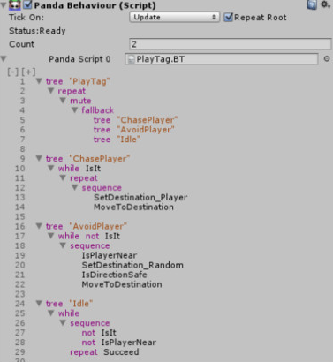
Behavior Trees - But I can just download it…
Panda BT is a nice example of this. It's got both a Free and a Pro version.
In Unity, it looks
like this:

Slide 10
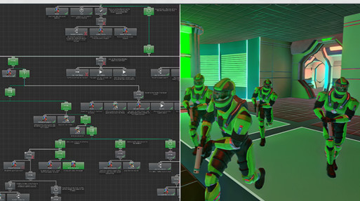
Behavior Trees - But I can just download it…
Something like Behavior Designer is a bit more sophisticated - but costs $80.

Slide 11
Behavior Trees - But I can just download it…
However, while these might be fine for your own independent projects, you can't use asset store items in your Capstone project.
This means you need to write the AI in your game using other means.
One of those other means, is to use the built in state machines that Unity provides, driven by an animation controller.

Slide 12
Behavior Trees - If I do download it…
What are the pros and cons of each?
If you opt for a lower end one, like Panda, Then you're looking at editing text files, with no error checking. Remember how fun that was in Python?
The higher end ones avoid most of those problems, and have better debugging tools to boot.

Slide 13
Behavior Trees - If I do download it…
In the end, you're going to get what you paid for. However, you're still not going to be able to make use of it for Capstone, so let's look at an alternative - using Finite State Machines to build your AI

Slide 14
Old school AI - FSM
With a Finite State machine (FSM), you define a number of states, and transitions that can move you from one state to another.
At any given moment, an entity will be in a particular state. That state controls what they are going at the moment.
The transitions control what causes a shift.

Slide 15
Old school AI - FSM
Here's a simple example AI. Note that if we are guarding, we can switch to attacking. If we are attacking, we can shift to either guarding or defending, and if we're defending, we can only switch to attacking.
Guard
Attack
Defend

Slide 16
Old school AI - FSM
What controls the transitions? Well, if you're using the built in FSM that Unity provides, you can rig things up to either do simple variable comparisons to switch, or call more complicated functions to make that call.
From swapping from guard to attack, it might be that an enemy is in range. From attack to defend, perhaps a team mate's health is too low.

Slide 17
Old school AI - FSM
The FSM built into Unity was originally intended to manage transitions between animation states - Idle to Walk to Run to Jump to Landing etc…
Because of this, it made use of an animation controller to switch between the states. This component would be given some time during updates, and perform the shifts from one state to another automatically.

Slide 18
Old school AI - FSM
Getting started in Unity.
Create an Animator Controller in the asset area. Name it EnemyFSM. Open it up, and you'll now be in the animator window
We're going to add some states next.

Slide 19
Old school AI - FSM
Create a Patrol State.
Right click in the window, and select Create State -> Empty. Click the state, then the inspector tab to allow you to rename it to "Patrol"

Slide 20
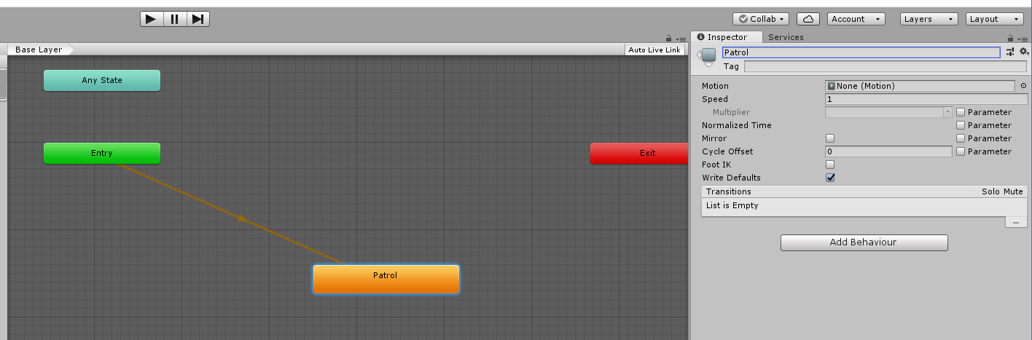
Old school AI - FSM
It should look like this:
Next is to add the class that executes for that state. Hit the add Behavior Button, then Select New Script, and name it Patrol.

Slide 21
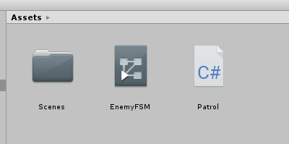
Old school AI - FSM
The asset area should look like this:
We now need to open the generated Patrol Script. It will have 5 functions, which oddly enough are all commented out. Uncomment the first 3, and delete the last two.

Slide 22
Old school AI - FSM
A state machine has three important methods.
OnStateEnter, which is called when we enter the state from another state.
OnStateUpdate, which is called every frame that we are still in this state.
OnStateExit, which is called just before we transition to another state.
The other two are only for animation.

Slide 23
Old school AI - FSM
There is one limitation which may be a bit surprising.
If you add a public variable, it will show up in the inspector, allowing you to tweak that value.
However, you cannot define a public GameObject and drag things in from the
Scene Hierarchy. You can drag prefabs in…

Slide 24
Old school AI - FSM
This means that if we want to define a number of waypoints, we need another way to do that. There are two easy ways to do this.
The first (which we will use) is to search the scene for them. The second is to search for a single object that can hand the information out to us.

Slide 25
Old school AI - FSM
Searching the scene works, but has one limitation - the order the objects are accessed is the same order that they appear in the hierarchy. You'll tag them in the inspector (near the top right) and then look for them with code like:
waypoints = GameObject.FindGameObjectsWithTag("waypoint");

Slide 26
Old school AI - FSM
We don't want to search the scene every time we enter this state, so where does that code go?
Well, firstly, we need the array of GameObjects, so add a member variable
GameObject[] waypoints;

Slide 27
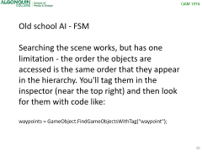

Old school AI - FSM
If we add an Awake method, it will only be called once after the scene has loaded. This is a good spot to get the waypoints. It will look like this:
GameObject[] waypoints;
void Awake()
{
waypoints = GameObject.FindGameObjectsWithTag("waypoint");
}

Slide 28
Old school AI - FSM
When we enter the Patrol state, we need to think about what we want to do.
Obviously, we'll find a waypoint and head there, then on to the next one and so on.
The easy way out is to always start by heading to the first waypoint.
A better choice would be to pick the closest.

Slide 29
Old school AI - FSM
In the OnstateEnter is where this code goes. Obviously we'll need a member variable to keep track of which waypoint we want to go to. We'll also add a member variable to keep track of the GameObject that is running this state machine.
int currentWP = 0;
GameObject Enemy;

Slide 30
Old school AI - FSM
// This is done to shorten our code.
Enemy = animator.gameObject;
// do we have anywhere to go?
if (waypoints.Length == 0)
{
return; // no, so don't bother picking one
}

Slide 31
Old school AI - FSM
currentWP = 0;
// find the distance to the first waypoint
float distance = Vector3.Distance(waypoints[0].transform.position, Enemy.transform.position);
// then loop over the rest until we find the closest one.
// start at one, cause we already know the distance to the first one
for (int i = 1; i < waypoints.Length; i++)
{
float dis = Vector3.Distance(waypoints[i].transform.position, Enemy.transform.position);
if (dis < distance)
{
distance = dis;
currentWP = i;
}
}

Slide 32
Old school AI - FSM
When we're in OnStateUpdate, we want to move our self towards the current waypoint, turning as needed to head to it.
We also need to, if we've arrived at the current waypoint, pick the next waypoint along the path.

Slide 33
Old school AI - FSM
// if none, we're not going anywhere
if (waypoints.Length == 0)
{
return;
}
// are we there yet? the 3.0 is "close enough"
if (Vector3.Distance(waypoints[currentWP].transform.position,
Enemy.transform.position) < 3.0f)
{
currentWP++;
if (currentWP >= waypoints.Length)
{
currentWP = 0; // wrap around to the start again
}
}

Slide 34
Old school AI - FSM
// which direction should we head
Vector3 direction = waypoints[currentWP].transform.position -
Enemy.transform.position;
// rotate from the direction we are facing towards the desired direction
// how fast we rotate is controlled by the 1.0f and the elapsed time
Enemy.transform.rotation = Quaternion.Slerp(Enemy.transform.rotation, Quaternion.LookRotation(direction), 1.0f * Time.deltaTime);
// finally, move forward along our Enemy's Z axis
// (which is our forward vector) at a speed of two units per second.
Enemy.transform.Translate(0,0,2.0f * Time.deltaTime)

Slide 35
Old school AI - FSM
The final step is to connect things together.
Add a GameObject (or several in a hierarchy) and name the root object "Enemy". Add a number of GameObjects (spheres work well), and remember to tag them as "waypoint" in the inspector.

Slide 36
Old school AI - FSM
The final step is to connect things together.
Add a GameObject (or several in a hierarchy) and name the root object "Enemy". Add a number of GameObjects (spheres work well), and remember to tag them as "waypoint" in the inspector.

Slide 37
Old school AI - FSM
Select the Enemy object in the hierarchy, then add an Animator component to it in the inspector.
Drag our FSM out of the assets, and drop it into the Controller well in the Animator component.
Hit Play, and you'll watch the enemy move along it's patrol Path.

Slide 38
Old school AI - FSM
At this point, you're probably saying - I could have done that with Update on a script on the game object, and you're absolutely correct. With only one state, this is not much of a state machine. We go in, and never leave. Effectively we've got a Roach Motel state machine…
We need another state (or two) and a way to get to them (and back to Patrol again)

Slide 39
Old school AI - FSM
What do we want our Enemy to do, and why?
Now we're thinking about AI behavior.
Lets define the desired behavior as:
If the player is nearby, stop and shoot at them. If the player gets out of range, go back to patrol. We'll call this state "Attack"

Slide 40
Old school AI - FSM
Create a new state in the FSM, call it Attack, and create a corresponding behavior for it, also called Attack.
We'll fill in the behavior shortly. We're going to need to do two more things - we need a player to shoot at, and transitions between Patrol and Attack

Slide 41
Old school AI - FSM
Adding the player is easy. Drop a capsule into the scene, and tag it as "player". We're not even going to have a script associated with it - we'll drag it around in the scene view to trigger the enemy AI.
By this point you should probably have 8 items in the hierarchy including the camera and the light

Slide 42
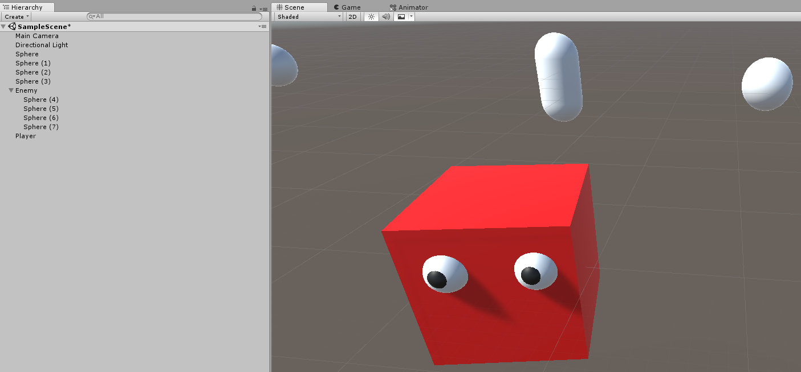
Old school AI - FSM
The camera, the light, 4 waypoints, the enemy and the player. In my version, I've added googly eyes to the enemy (a couple of spheres) to make it look creepier, and to see which way is forward.

Slide 43

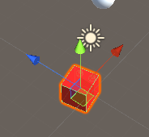
Old school AI - FSM
Play around with the constants a bit - we want the enemy moving smoothly.
One more thing.
The buttons near the top - one is tagged global.
That shows the axis on the selected object in world space.

Slide 44
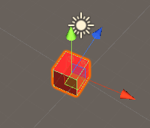
Old school AI - FSM
click on it to toggle to the local view.
That shows the axis on the selected object in it's own space, with the blue axis (Z) pointing forward..

Slide 45
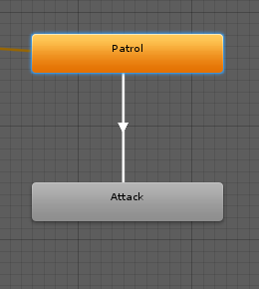
Old school AI - FSM
We need to create transitions to (and from) the attack state from the patrol state.
Right click Patrol, and select Make Transition. Drag the arrow that appears down to Attack, and release it.

Slide 46
Old school AI - FSM
Select it and it will turn blue, and the inspector will change to show details of that transition. You want to add a condition to trigger shifting from Patrol to Attack.
We'll shift to attack if the Player is within 3 units of the Enemy. We'll need to create (and while in patrol, set) a Parameter. This is on the left side of the animator tab.

Slide 47

Old school AI - FSM
Hit the plus there, and add a float. name it DistanceToPlayer. We also need to change the default value, other wise we'll think we're on top of the player, and attack immediately. 1000 works well for now.

Slide 48

Old school AI - FSM
Head back to the right side, and add a condition. Since we only have one parameter, it will be filled in by default. Select Less and 3.0 for the other fields.

Slide 49
Old school AI - FSM
We now need to update this value while Patrolling. We'll also need it in the Attack state, to move back to Patrol if we're out of range.
We could set this directly inside the Patrol and Attack state code, but we can also do it for the entire state machine from a script on the Enemy. Select the Enemy, and add a new script - EnemyAI

Slide 50
Old school AI - FSM
You need a reference to the player, so add one. (you'll need to save, then drag from the player capsule to the well in the enemy's script in the inspector)
public GameObject player;
We also need an animator.
Animator anim;

Slide 51
Old school AI - FSM
That gets set in the start method for the script.
void Start()
{
anim = GetComponent<Animator>();
}
Over to Update now. This is where the compiler won't be able to save you…

Slide 52
Old school AI - FSM
anim.SetFloat("DistanceToPlayer", Vector3.Distance(transform.position, player.transform.position);
The gotcha here is that string. Misspell it, and you'll find out at runtime that there is no such parameter. Autocomplete will not help either. You just have to get it right.
Save and fire it up.

Slide 53
Old school AI - FSM
If you open the animator tab, you can watch it executing the Patrol state, and the DistanceToPlayer parameter will be changing. Eventually, it will get close enough, and you'll shift over to Attack, which does nothing, and stay there, since we don't have a way to get back.
Add another transition from Attack back to Patrol. Set the condition to Greater 3.0.

Slide 54
Old school AI - FSM
Now if you run the program, you will see the Enemy will stop if he's close to the Player. Move the Player in the scene tab, and the Enemy will go back to Patrolling again.

Slide 55
Old school AI - FSM
Hands on: If you've not been following along, get the stuff above up and running.
If you want the Enemy to glare at the player when close, add the following into the OnStateUpdate in Attack:
(it will rotate them to face the player)

Slide 56
Old school AI - FSM
GameObject Enemy = animator.gameObject;
GameObject player = Enemy.GetComponent<EnemyAI>().player;
Vector3 direction = player.transform.position - Enemy.transform.position;
Enemy.transform.rotation =
Quaternion.Slerp(animator.gameObject.transform.rotation,
Quaternion.LookRotation(direction), 2.0f * Time.deltaTime);

